Slide 1


“Information Security”
Lecture # 9
Dr. Engr. M Malook Rind
Ph.D (I.T), ME (CSN), MBA (MIS), BE (CS)
CCNA, CCNP, Juniper Certified.
Professor (Computer Science)

Slide 2

Contents
Web Server, Web Application, and SQL Attacks and Countermeasures
Dr. M Malook Rind Information Security Lecture 9

Slide 3
Web Server, Web Application, and SQL Attacks and Countermeasures
Different Web Server Attack and Countermeasures
Different Web Application Threats, Attacks and Countermeasures
Different Types of SQL Injection Attacks and Countermeasures
Dr. M Malook Rind Information Security Lecture 9

Slide 4
Web Server Attacks
Dr. M Malook Rind Information Security Lecture 9

Slide 5
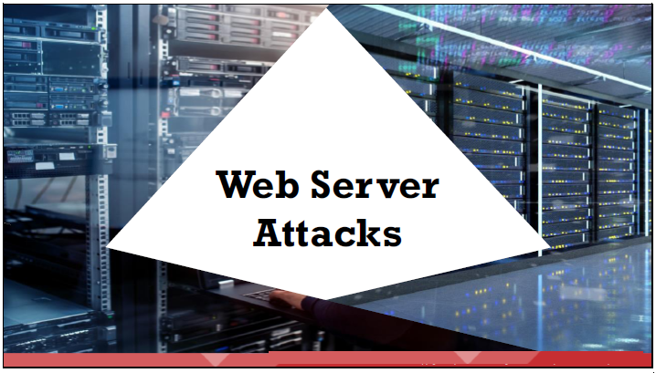
Web Server Attacks
Web applications are becoming increasingly vulnerable to sophisticated threats and attack vectors.
An attacker can use many techniques to compromise a web server, such as Domain Name System (DNS) server hijacking, DNS amplification, directory traversal, website defacement, web server misconfiguration, HTTP response splitting, web cache poisoning, Secure Shell (SSH) brute force, web server password cracking, and Server-Side Request Forgery (SSRF) attack.
Dr. M Malook Rind Information Security Lecture 9

Slide 6
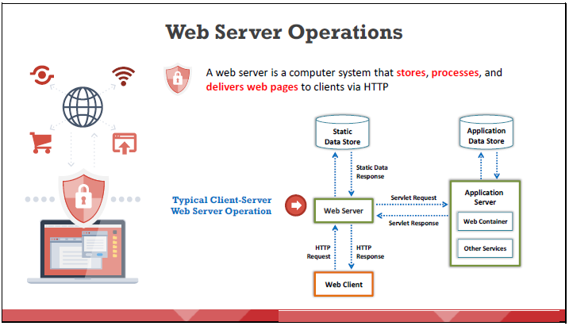
Web Server Attacks
Dr. M Malook Rind Information Security Lecture 9

Slide 7
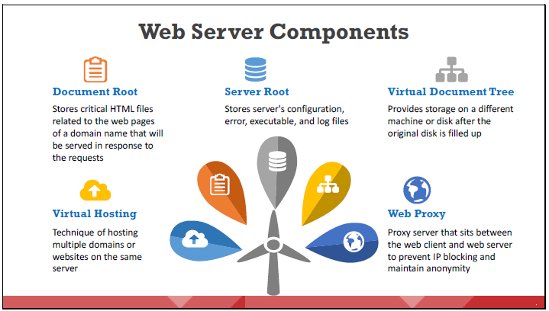
Web Server Attacks
A web server consists of the following components
Dr. M Malook Rind Information Security Lecture 9

Slide 8
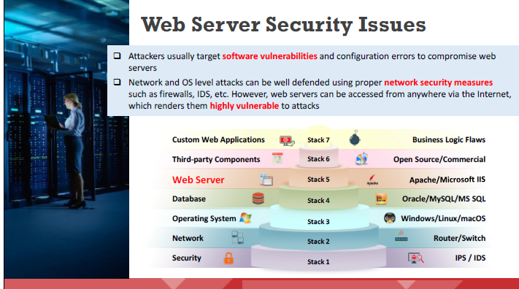
Web Server Attacks
Apache, Microsoft IIS, Nginx, Google, and Tomcat are some of the most widely used web server software. Attackers can exploit poorly configured web servers with known vulnerabilities to compromise the security of web applications.
Dr. M Malook Rind Information Security Lecture 9

Slide 9
Web Server Attacks
Common Goals behind Web Server Hacking:
Stealing credit-card details or other sensitive credentials using phishing techniques
Integrating the server into a botnet to perform denial of service (DoS) or distributed DoS (DDoS) attacks
Compromising a database
Obtaining closed-source applications
Hiding and redirecting traffic
Escalating privileges
Some attacks are performed for personal reasons, rather than financial gains
For pure curiosity
For completing a self-set intellectual challenge
For damaging the target organization’s reputation
Dr. M Malook Rind Information Security Lecture 9

Slide 10
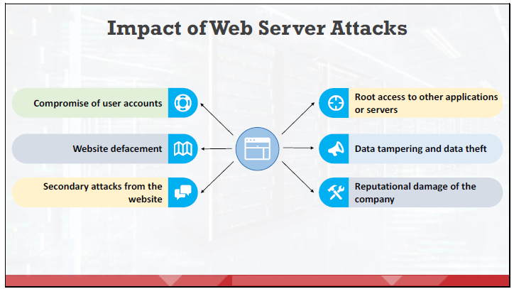
Web Server Attacks
Attackers can cause various kinds of damage to an organization by attacking a web server
If the attacker compromises a user account, they can gain a large amount of useful information and can use the compromised user account to launch further attacks on the web server.
Attackers can completely change the appearance of a website by changing the visuals and displaying different pages with messages of their own.
An attacker can use the server to launch further attacks on various websites or client systems.
Root access is the highest privilege level to log in to a server. Attackers can perform any action once they attain root access to the server.
An attacker can alter or delete the data of a web server and even replace the data with malware to compromise users who connect to the web server.
Attackers can attain access to sensitive data such as financial records, future plans, or the source code of a program.
Web server attacks may expose the personal information of a company’s customers to the public, damaging the reputation and customer faith of the company.
Dr. M Malook Rind Information Security Lecture 9

Slide 11
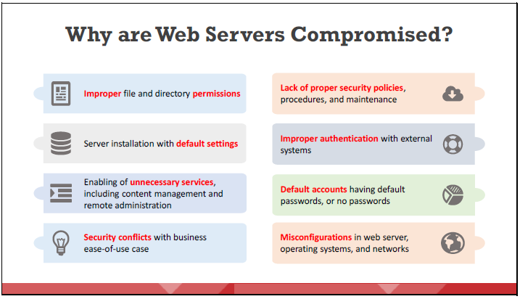
Web Server Attacks
Some oversights that can compromise a web server.
Dr. M Malook Rind Information Security Lecture 9

Slide 12
Web Server Attacks
Security Flaws Affecting Web Server Security:
A web server configured by poorly trained system administrators may have security vulnerabilities.
Inadequate knowledge, negligence, laziness, and inattentiveness toward security can pose the greatest threats to web server security.
Some common oversights that make a web server vulnerable to attacks:
Failing to update the web server with the latest patches
Using the same system administrator credentials everywhere
Allowing unrestricted internal and outbound traffic
Running unhardened applications and servers
Dr. M Malook Rind Information Security Lecture 9

Slide 13
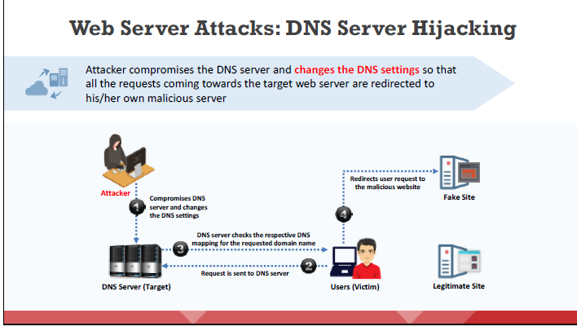
Web Server Attacks
Some of the most common Web Server Attacks include:
The Domain Name System (DNS) resolves a domain name to its corresponding IP address
Dr. M Malook Rind Information Security Lecture 9

Slide 14
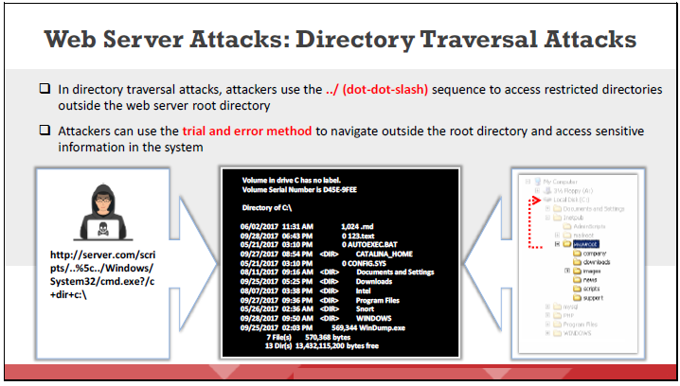
Web Server Attacks
Also known as path traversal attack allows and an attacker to access files and directories that should not be allowed to access. The attacker usually performs this attack with the help of a browser.
Poorly patched or configured web server software can make the web server vulnerable to a directory traversal attack.
A web server is vulnerable to this attack if it accepts input data from a browser without proper validation.
Dr. M Malook Rind Information Security Lecture 9

Slide 15
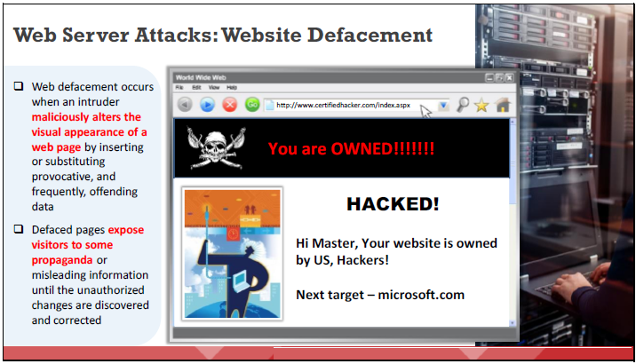
Web Server Attacks
Website defacement refers to unauthorized changes made to the content of a single web page or an entire website, resulting in changes to the visual appearance of the web page or website.
Hackers break into web servers using a variety of methods, such as MySQL injection, and alter the hosted website by injecting code to add images, popups, or text to a page in such a manner that the visual appearance of the page changes.
Dr. M Malook Rind Information Security Lecture 9

Slide 16
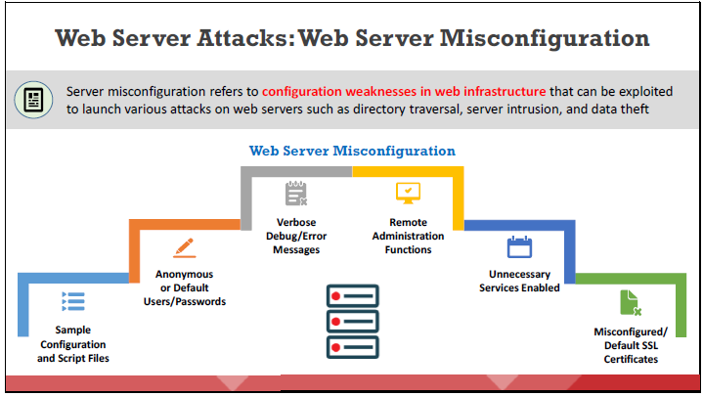
Web Server Attacks
Dr. M Malook Rind Information Security Lecture 9

Slide 17
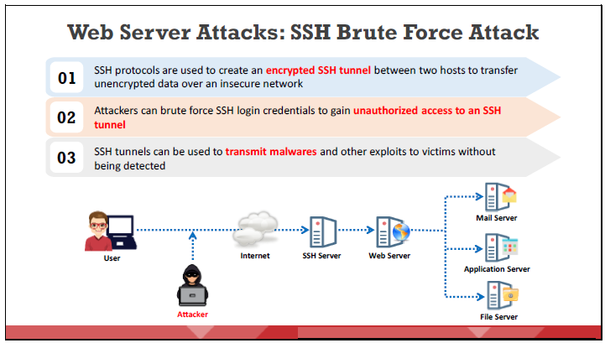
Web Server Attacks
To perform an attack attacker scans the entire SSH server using bots (performs a port scan on TCP port 22) to identify possible vulnerabilities.
Dr. M Malook Rind Information Security Lecture 9

Slide 18
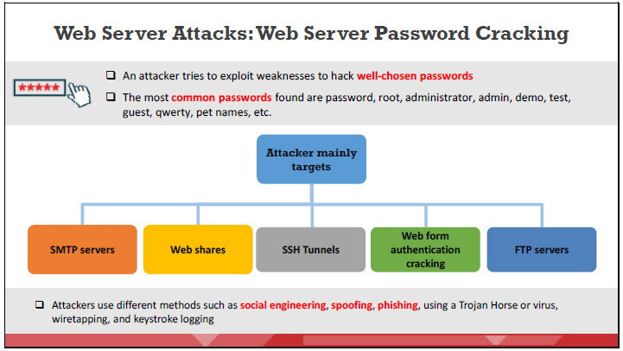
Web Server Attacks
Password cracking is the most common method of gaining unauthorized access to a web server by exploiting flawed and weak authentication mechanisms.
Once the password is cracked, an attacker can use the password to launch further attacks.
Dr. M Malook Rind Information Security Lecture 9

Slide 19
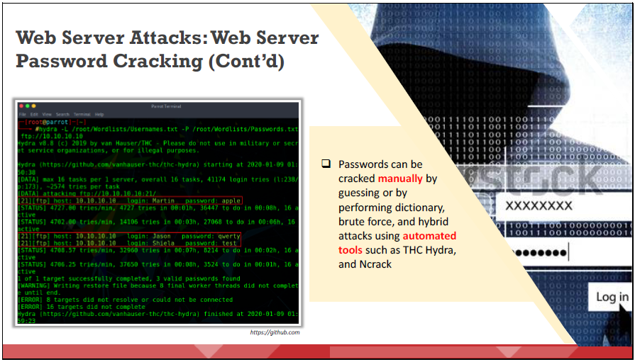
Web Server Attacks
Dr. M Malook Rind Information Security Lecture 9

Slide 20
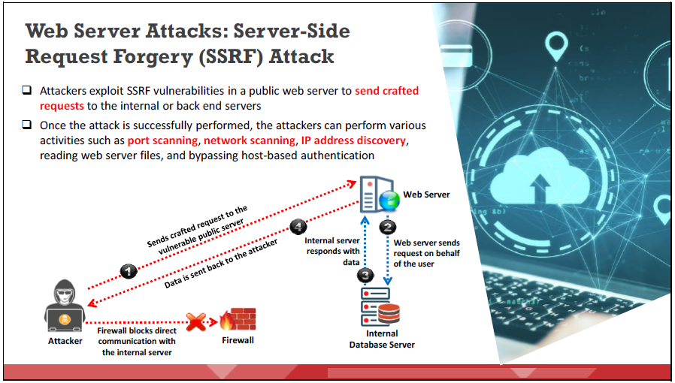
Web Server Attacks
attackers leverage SSRF vulnerabilities in Internet-facing web servers to gain access to the backend servers that are protected by a firewall.
Dr. M Malook Rind Information Security Lecture 9

Slide 21
Web Server Attack Countermeasures
Dr. M Malook Rind Information Security Lecture 9

Slide 22
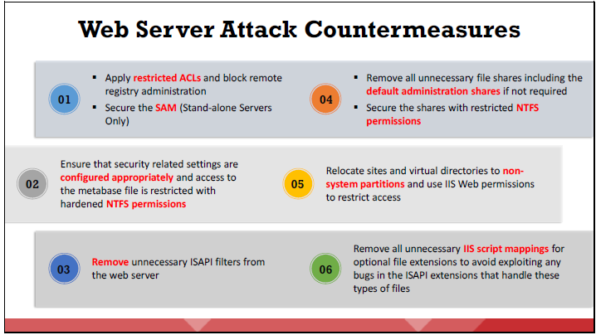
Web Server Attacks - Web Server Attack Countermeasures
Following are some measures to defend against web server attacks
Dr. M Malook Rind Information Security Lecture 9

Slide 23
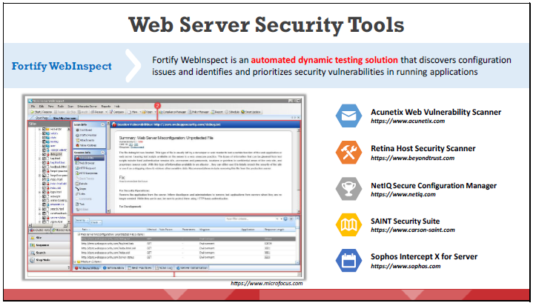
Web Server Attacks - Web Server Attack Countermeasures
There are various countermeasures to defend against web server attacks.
Dr. M Malook Rind Information Security Lecture 9

Slide 24
Web Application Attacks
Dr. M Malook Rind Information Security Lecture 9

Slide 25
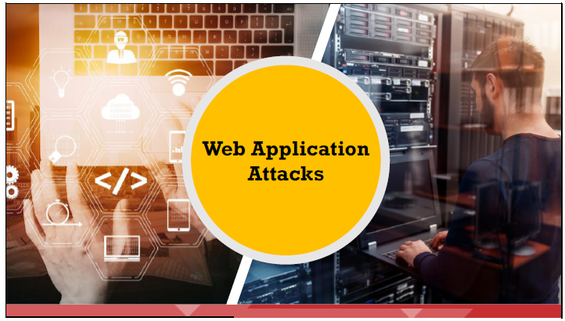
Web Application Attacks
With the ever-increasing vulnerabilities and cyber-attacks on web applications, along with the advanced techniques and nature of these attacks, organizations and security professionals need to re-assess their approach in securing web applications.
Dr. M Malook Rind Information Security Lecture 9

Slide 26
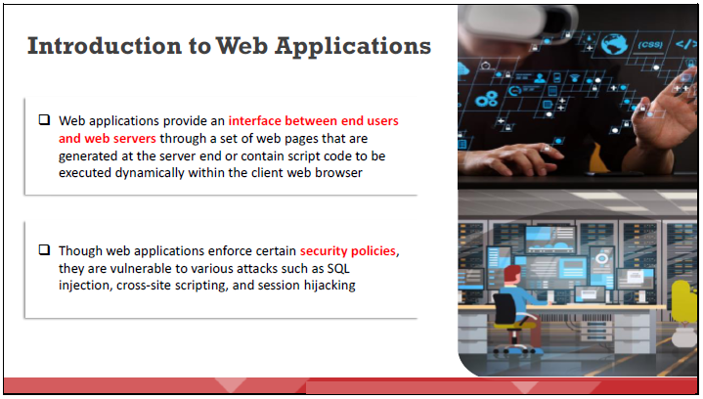
Web Application Attacks
Web applications allow users to perform specific tasks such as searching, sending emails, connecting with friends, online shopping, and tracking and tracing.
Dr. M Malook Rind Information Security Lecture 9

Slide 27
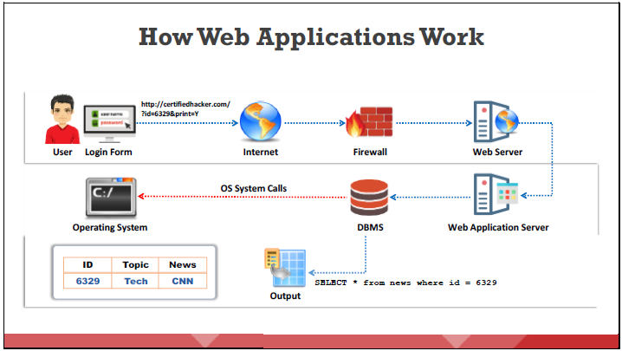
Web Application Attacks
The main function of web applications is to fetch user-requested data from a database. When a user clicks or enters a URL in a browser, the web application immediately displays the requested website content in the browser.
Dr. M Malook Rind Information Security Lecture 9

Slide 28
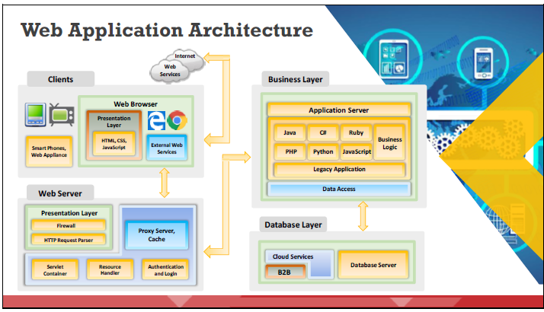
Web Application Attacks
The web application architecture includes different devices, web browsers, and external web services that work with different scripting languages to execute the web application. It consists of three layers:
1. Client or presentation layer 2. Business logic layer 3. Database layer.
Dr. M Malook Rind Information Security Lecture 9

Slide 29
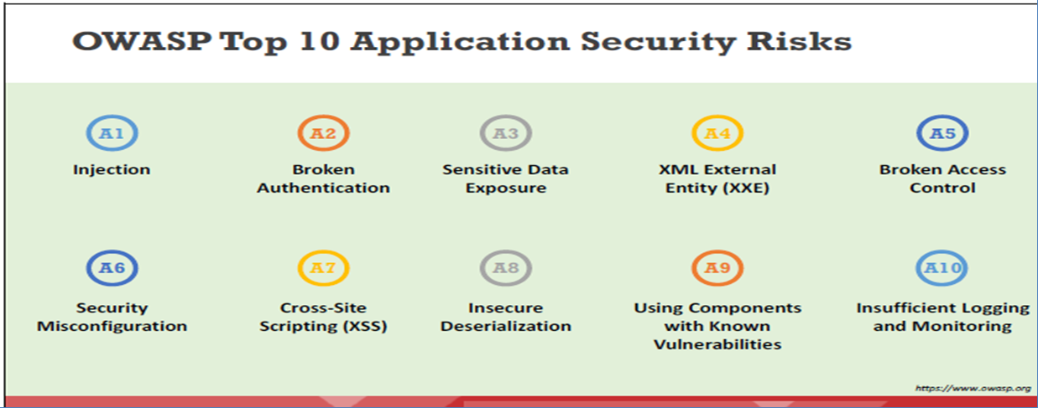
Web Application Attacks
OWASP (Open Worldwide Application Security Project) is an online community that produces freely available articles, methodologies, documentation, tools, and technologies in the field of web application security
specifies the top 10 vulnerabilities and flaws of web applications.
Dr. M Malook Rind Information Security Lecture 9

Slide 30
Web Application Attack Countermeasures
Dr. M Malook Rind Information Security Lecture 9

Slide 31
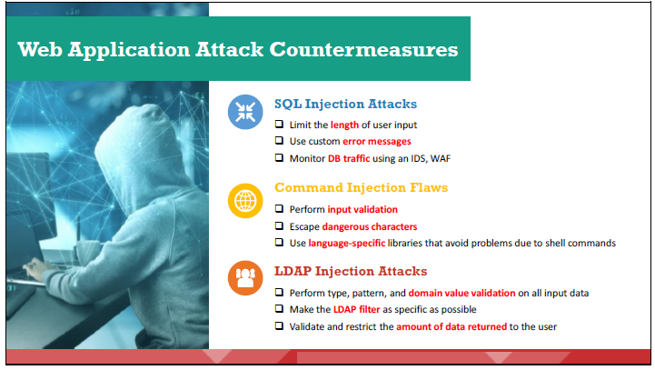
Web Application Attacks - Web Application Attack Countermeasures
Dr. M Malook Rind Information Security Lecture 9

Slide 32
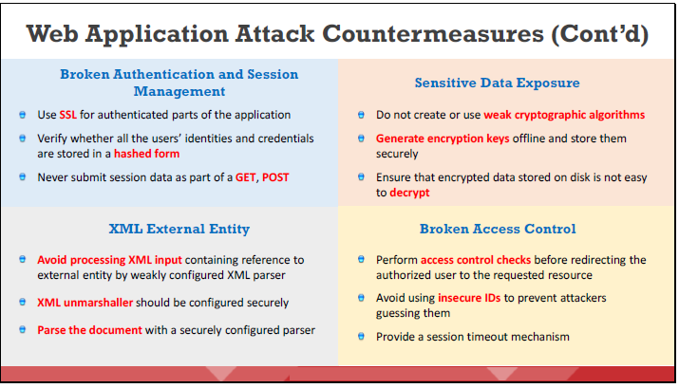
Web Application Attacks - Web Application Attack Countermeasures
Dr. M Malook Rind Information Security Lecture 9

Slide 33
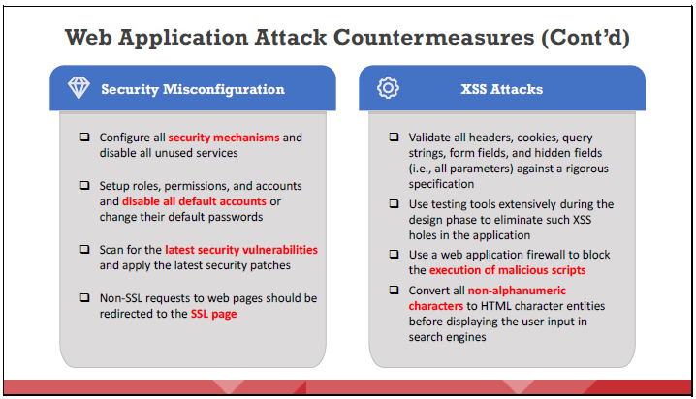
Web Application Attacks - Web Application Attack Countermeasures
Dr. M Malook Rind Information Security Lecture 9

Slide 34
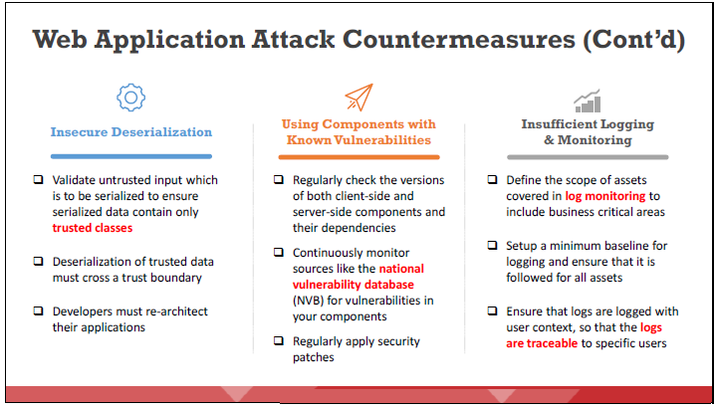
Web Application Attacks - Web Application Attack Countermeasures
Dr. M Malook Rind Information Security Lecture 9

Slide 35
SQL Injection Attacks
Dr. M Malook Rind Information Security Lecture 9

Slide 36
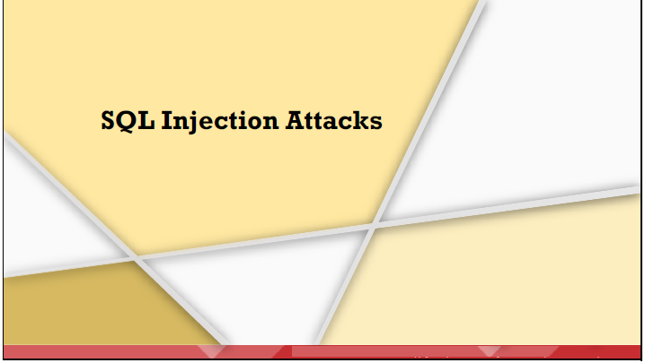
SQL Injection Attacks
SQL injection is the most common and devastating attack that attackers can launch to take control of a website.
Attackers use various tricks and techniques to view, manipulate, insert, and delete data from an application’s database and compromise data-driven web applications, causing organizations to incur severe losses in terms of money, reputation, data, and functionality.
Dr. M Malook Rind Information Security Lecture 9

Slide 37
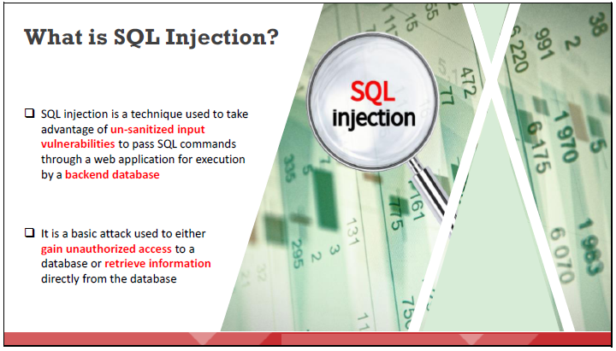
SQL Injection Attacks
SQL injection is a code injection technique used to attack data-driven applications, in which malicious SQL statements are inserted into an entry field for execution
Such attacks are possible because of a flaw in web applications and not because of any issue with the database or the web server.
SQL injection attacks use a series of malicious SQL queries or SQL statements to manipulate the database directly.
Dr. M Malook Rind Information Security Lecture 9

Slide 38
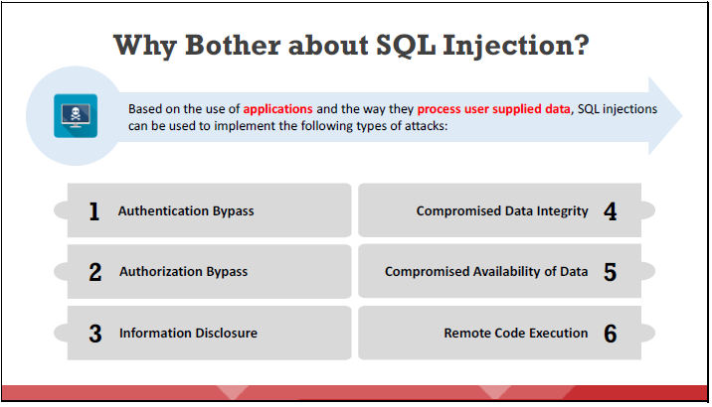
SQL Injection Attacks
SQL injection is a major issue for all database-driven websites.
Dr. M Malook Rind Information Security Lecture 9

Slide 39
SQL Injection Attacks
SQL injection can be used to implement the following attacks:
Authentication Bypass: Using this attack, an attacker logs onto an application without providing a valid username and password, and gains administrative privileges.
Authorization Bypass: Using this attack, an attacker alters authorization information stored in the database by exploiting an SQL injection vulnerability.
Information Disclosure: Using this attack, an attacker obtains sensitive information that is stored in the database.
Compromised Data Integrity: Using this attack, an attacker defaces a web page, inserts malicious content into web pages, or alters the contents of a database.
Compromised Availability of Data: Using this attack, an attacker deletes the database information, delete logs, or audit information stored in a database.
Remote Code Execution: Using this attack, an attacker compromises the host OS.
Dr. M Malook Rind Information Security Lecture 9

Slide 40
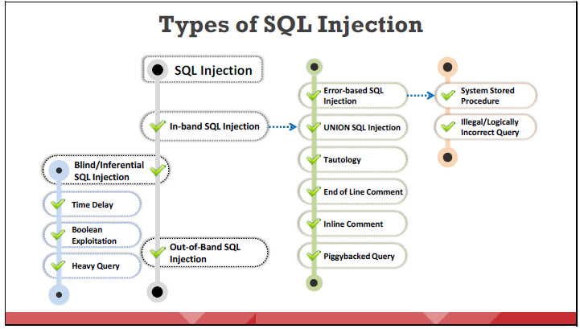
SQL Injection Attacks
In an SQL injection attack, the attacker injects malicious code through an SQL query that can read sensitive data and even can modify (insert/update/delete) it. Three main types of SQL injection include:
1. In-band SQL Injection, 2. Blind/Inferential SQL Injection 3.Out-of-Band SQL Injection
Dr. M Malook Rind Information Security Lecture 9

Slide 41
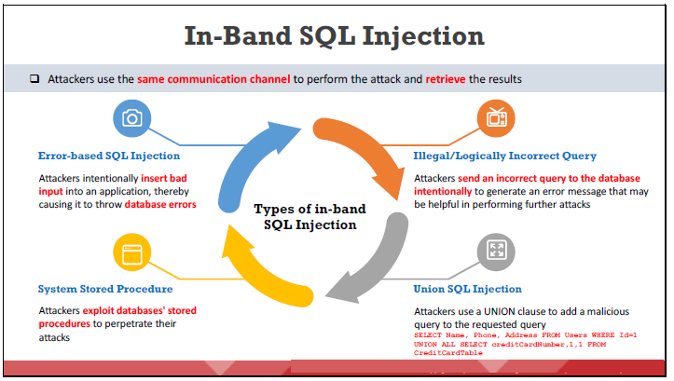
SQL Injection Attacks
In-band attacks are commonly used and easy-to exploit SQL injection attacks.
Most commonly used in-band SQL injection attacks are error-based SQL injection.
Dr. M Malook Rind Information Security Lecture 9

Slide 42
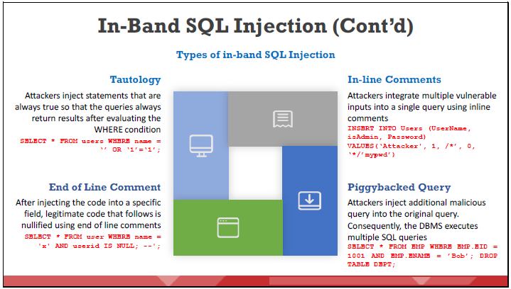
SQL Injection Attacks
Dr. M Malook Rind Information Security Lecture 9

Slide 43
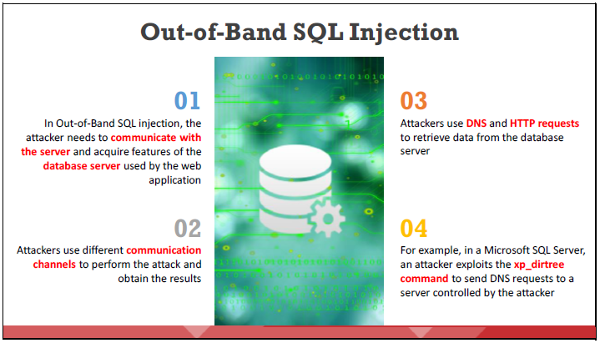
SQL Injection Attacks
Out-of-band SQL injection attacks are difficult to perform.
Dr. M Malook Rind Information Security Lecture 9

Slide 44
SQL Injection Attack Countermeasures
Dr. M Malook Rind Information Security Lecture 9

Slide 45
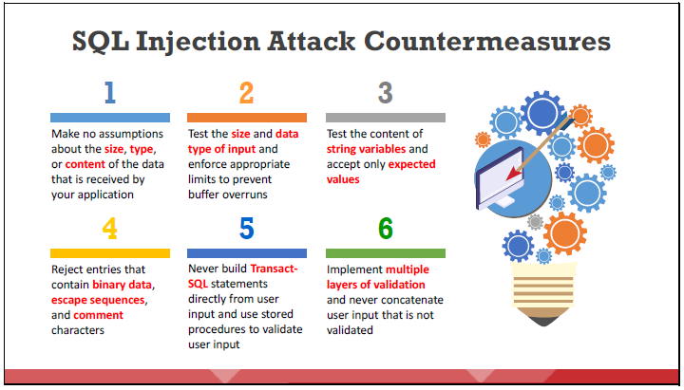
SQL Injection Attacks - SQL Injection Attack Countermeasures
To defend against SQL injection, the developer needs to take proper care in configuring and developing an application
The developer should use the best practices and countermeasures to prevent applications from becoming vulnerable to SQL injection attacks.
Some countermeasures to defend against SQL injection attacks are listed below:
Dr. M Malook Rind Information Security Lecture 9

Slide 46
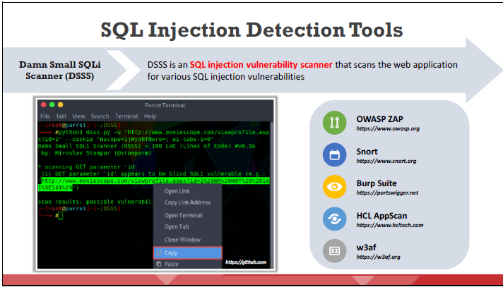
SQL Injection Attacks - SQL Injection Attack Countermeasures
SQL injection detection tools help in the detection of SQL injection attacks by monitoring HTTP traffic and SQL injection attack vectors, and they determine if the web application or database code suffers from SQL injection vulnerabilities.
Dr. M Malook Rind Information Security Lecture 9

Slide 47
Thanks
Dr. M Malook Rind Information Security Lecture 9

